Slide 1
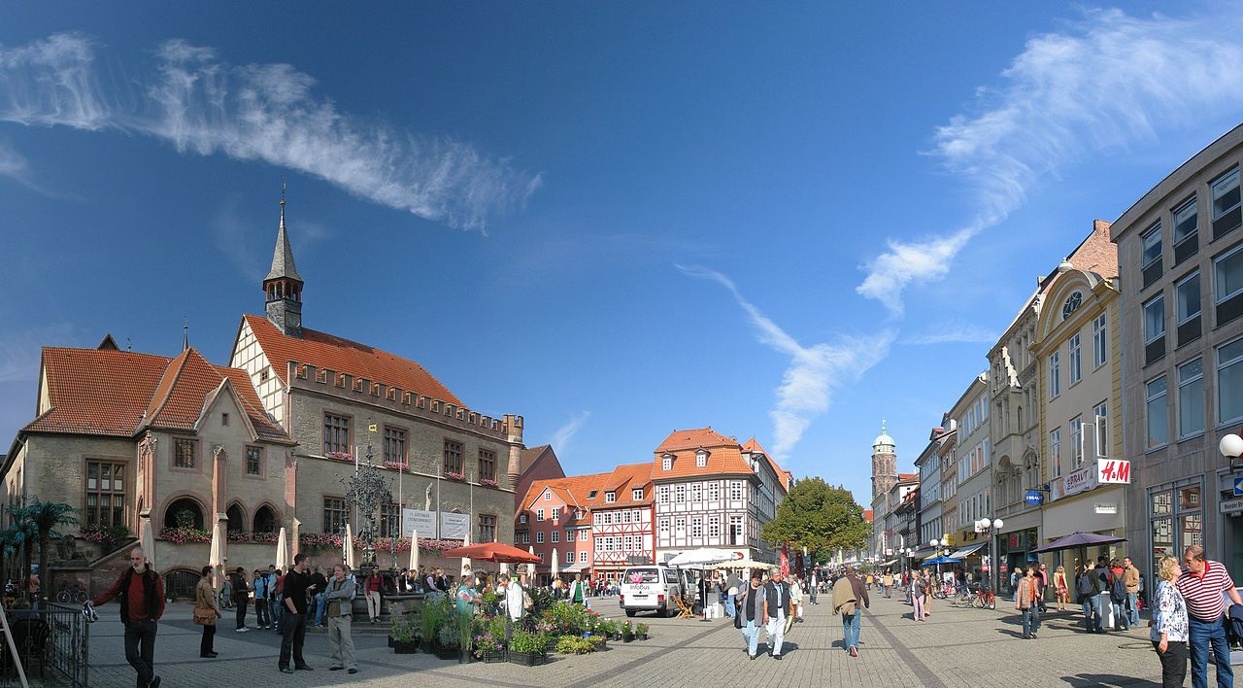
Towards improved Scene and Action Understanding
Florentin Wörgötter
Georg-August Universität Göttingen, Inst. f. Physik 3 and
Bernstein Center for Computational Neuroscience
Photo by Daniel Schwen - Own work, CC BY 2.5, https://commons.wikimedia.org/w/index.php?curid=1328957

Slide 2
Some Steps in Semantic Understanding
Schematization
(„Piaget“)
Action
Recognition
Prediction
Interpretation
(„multi-uses“)
Understanding
(„in context“)
Object
Affordance

Slide 3
Action

Slide 4
Some Steps in Semantic Understanding
Schematization
(„Piaget“)
Action
Recognition
Prediction
Interpretation
(„multi-uses“)
Understanding
(„in context“)
Object
Affordance

Slide 5
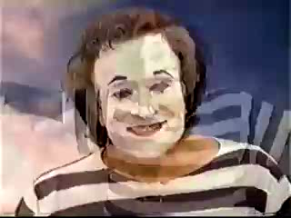
Our Action-Understanding (does not require objects)
Objects do not even exist in their own right………………

Slide 6
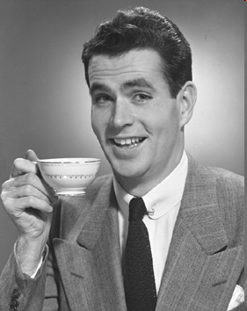
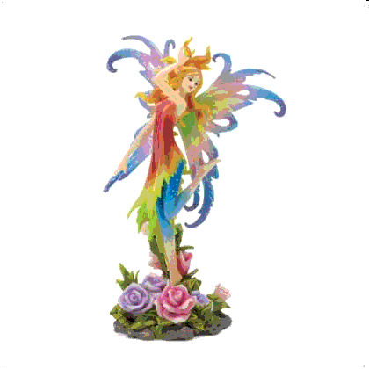

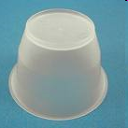
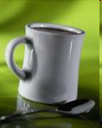
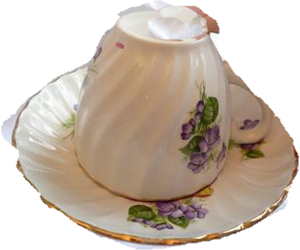

Drink
Decorate
„Cup“
„Pedestal“
Objects and Actions are inseparably intertwined!
Handlungsplan (action plan) lets a thing „become an object“
Wörgötter et al (2009). RAS, 57(4):420-432.
Krüger, N., Piater, J., Geib, C., Petrick, R., Steedman, M., Wörgötter, F., Ude, A., Asfour, T., Kraft, D., Omrcen, D., Agostini, A. and Dillmann, R. (2011). Object-Action Complexes: Grounded Abstractions of Sensorimotor Processes, RAS, 59(10), 740-757

Slide 7
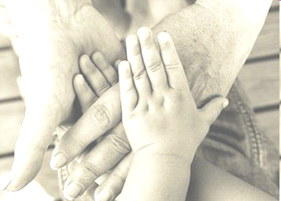
How to understand Actions without Objects
Manipulations:
chain actions (usually by hands) involving objects towards a goal
Something goes on between you and the object(s) and this is a „procedure“
Relational and procedural (grammar) information
is in the core of this

Slide 8
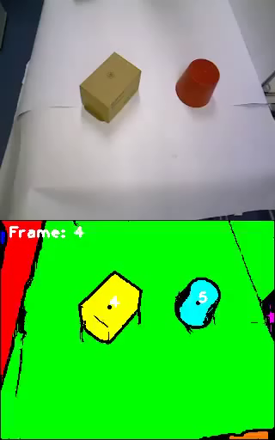
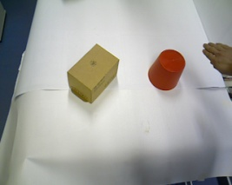
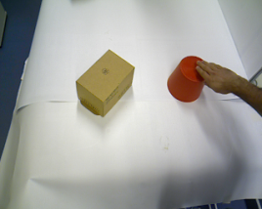
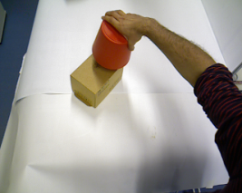
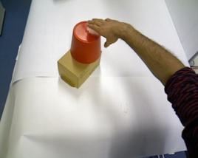
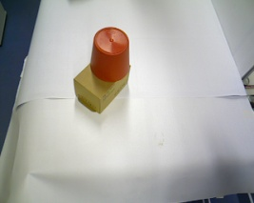
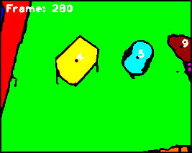
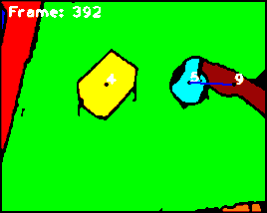
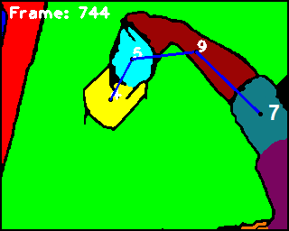
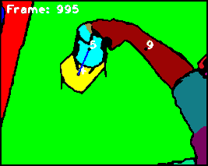
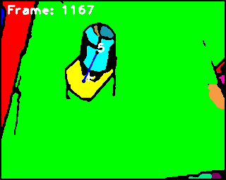
Algorithm – Semantic Event Chain (SEC)
9
5
9
5
9
5
4
4
9
4
7
4
4
5
5
ρ 4,5
N
N
T
T
T
ρ 4,7
A
A
N
A
A
ρ 4,9
N
N
N
N
A
ρ 5,7
A
A
N
A
A
ρ 5,9
N
T
T
N
A
ρ 7,9
A
A
T
A
A
1.time chunk
2.time chunk
3.time chunk
4.time chunk
5.time chunk

Slide 9
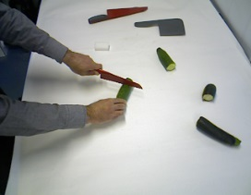
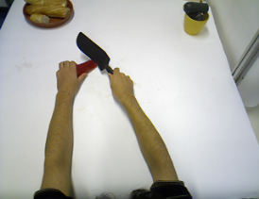
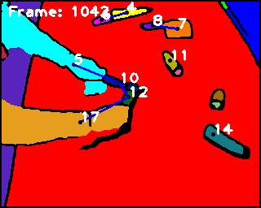
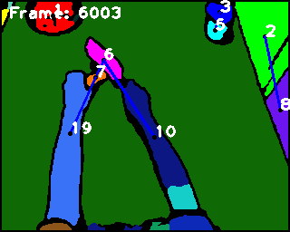
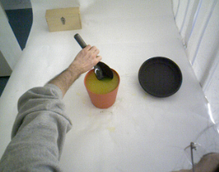
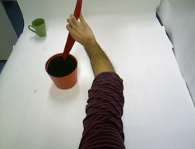
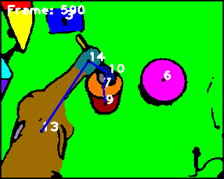
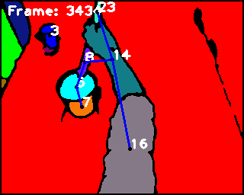
(Dis-)Similarity of Actions
“Cutting a Cucumber”
ρ 2,1
“Cutting a Paprika”
ρ 6,1
A
T
T
T
T
T
N
T
T
A
A
ρ 3,1
ρ 3,1
A
N
N
N
T
T
T
A
T
T
N
ρ 2,1
ρ 4,1
A
A
N
88 %
T
T
T
A
T
T
N
N
ρ 3,2
ρ 6,2
A
N
A
T
T
T
T
A
N
T
N
ρ 3,4
A
ρ 6,3
A
N
T
T
T
A
N
N
T
T
ρ 3,7
5X6
A
N
N
N
A
6X5
18 %
41 %
15%
39 %
“Stirring Orange juice”
“Stirring Coke”
ρ 5,6
ρ 7,1
A
N
N
T
T
T
N
T
N
N
T
T
T
T
ρ 3,6
A
ρ 3,1
A
N
T
T
N
A
A
N
T
T
N
N
N
ρ 4,6
A
T
ρ 5,1
N
T
N
T
A
N
T
T
T
T
T
ρ 3,5
94 %
N
T
A
ρ 3,7
A
T
T
T
A
A
N
T
T
T
N
A
ρ 4,5
N
T
T
N
N
N
T
ρ 5,7
A
T
ρ 3,8
N
T
N
T
A
T
N
N
T
T
T
T
5x7
6x7

Slide 10
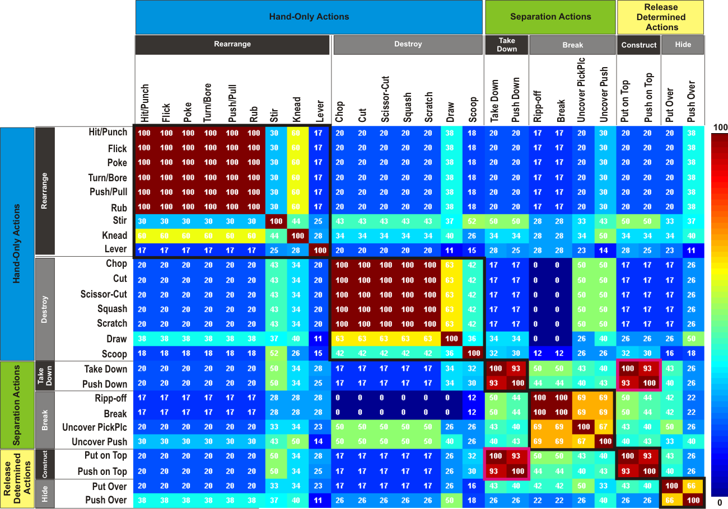
Similarity Analysis yields Action Recognition
Wörgötter et al. TAMD 2013

Slide 11
Some Steps in Semantic Understanding
Schematization
(„Piaget“)
Action
Recognition
Prediction
Interpretation
(„multi-uses“)
Understanding
(„in context“)
Object
Affordance

Slide 12
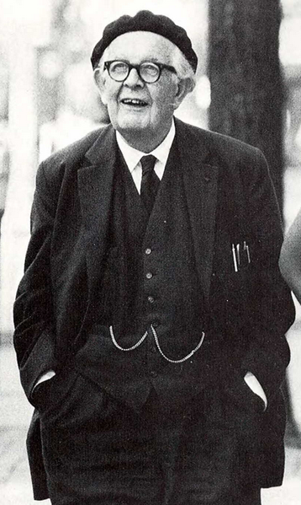
Piaget’s Accommodation and Assimilation
The Concept of Schemas
Assimilation: Entering new entities into existing schemas.
Accommodation: Storing new schemas.
Jean Piaget
1896 – 1980

Slide 13
Piaget’s Accommodation and Assimilation
Feature Space
 | Hairy | 4-legged | With tail | Vivipar | 2-legged | Feathery | Ovipar
Dog | x | x | x | x
Cat | x | x | x | x
Elephant |  | x | x | x
Platypus | x | x | x |  |  |  | x
Eagle |  |  |  |  | x | x | x
Peacock |  |  | x |  | x | x | x

Slide 14
Piaget’s Accommodation and Assimilation
 | Hairy | 4-legged | With tail | Vivipar | 2-legged | Feathery | Ovipar
Dog | x | x | x | x
Cat | x | x | x | x
Elephant |  | x | x | x
Platypus | x | x | x |  |  |  | x
Eagle |  |  |  |  | x | x | x
Peacock |  |  | x |  | x | x | x
Mammal
Schema

Slide 15
Piaget’s Accommodation and Assimilation
 | Hairy | 4-legged | With tail | Vivipar | 2-legged | Feathery | Ovipar
Dog | x | x | x | x
Cat | x | x | x | x
Elephant |  | x | x | x
Platypus | x | x | x |  |  |  | x
Eagle |  |  |  |  | x | x | x
Peacock |  |  | x |  | x | x | x
Mammal
Mammal
Assimilation

Slide 16
Piaget’s Accommodation and Assimilation
 | Hairy | 4-legged | With tail | Vivipar | 2-legged | Feathery | Ovipar
Dog | x | x | x | x
Cat | x | x | x | x
Elephant | - | x | x | x
Platypus | x | x | x |  |  |  | x
Eagle |  |  |  |  | x | x | x
Peacock |  |  | x |  | x | x | x
Mammal
Mammal
Mammal

Slide 17
Piaget’s Accommodation and Assimilation
 | Hairy | 4-legged | With tail | Vivipar | 2-legged | Feathery | Ovipar
Dog | x | x | x | x
Cat | x | x | x | x
Elephant | - | x | x | x
Platypus | x | x | x |  |  |  | x
Eagle |  |  |  |  | x | x | x
Peacock |  |  | x |  | x | x | x
Mammal
Mammal
Mammal
Assimilation
Mammal

Slide 18
Piaget’s Accommodation and Assimilation
 | Hairy | 4-legged | With tail | Vivipar | 2-legged | Feathery | Ovipar
Dog | x | x | x | x
Cat | x | x | x | x
Elephant | - | x | x | x
Platypus | x | x | x |  |  |  | x
Eagle |  |  |  |  | x | x | x
Peacock |  |  | x |  | x | x | x
Mammal
Mammal
Mammal
Mammal
Bird
Accomodation

Slide 19
Piaget’s Accommodation and Assimilation
 | Hairy | 4-legged | With tail | Vivipar | 2-legged | Feathery | Ovipar
Dog | x | x | x | x
Cat | x | x | x | x
Elephant |  | x | x | x
Platypus | x | x | x |  |  |  | x
Eagle |  |  |  |  | x | x | x
Peacock |  |  | x |  | x | x | x
Mammal
Mammal
Mammal
Mammal
Bird
Bird
Assimilation

Slide 20
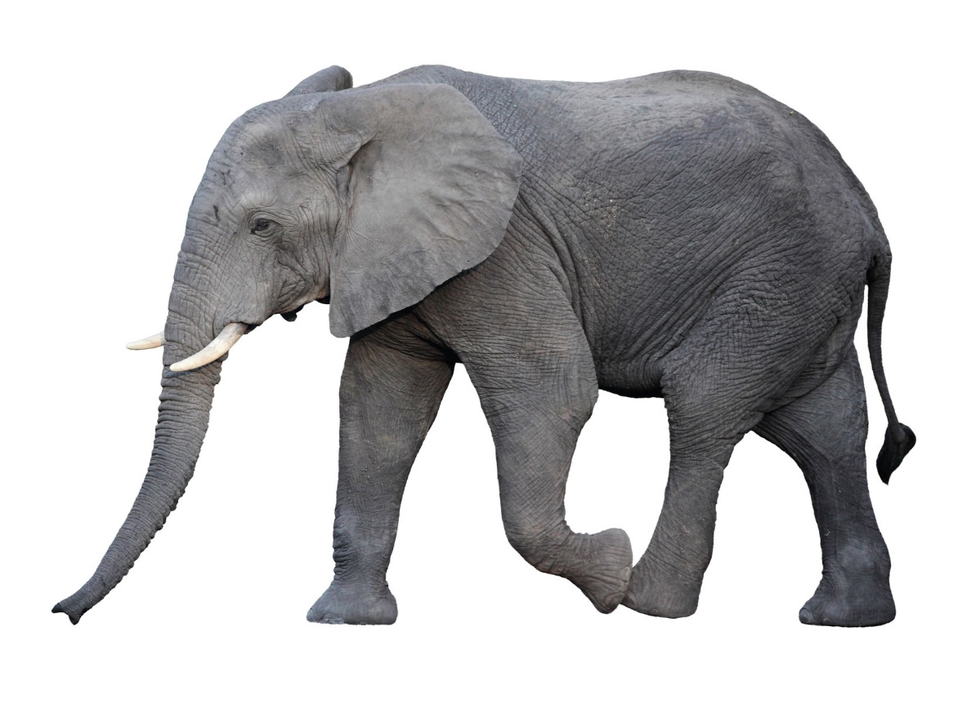
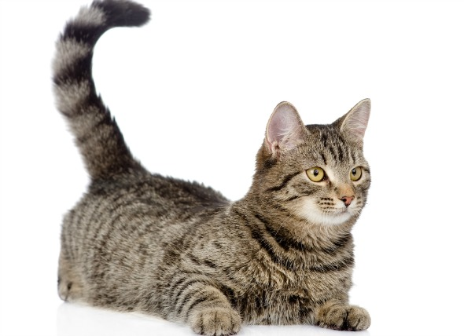
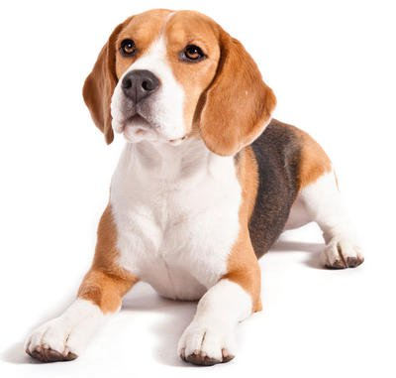
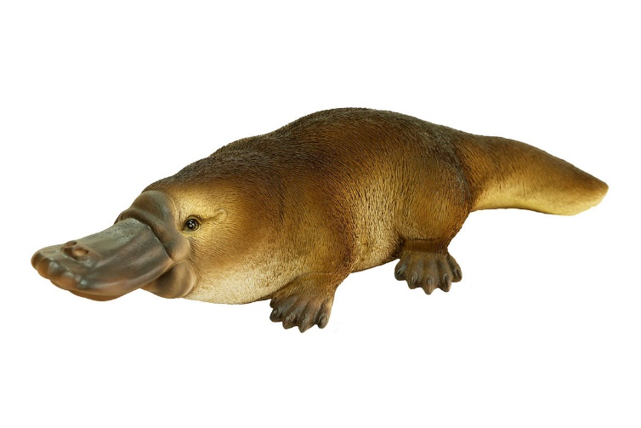
Piaget’s Accommodation and Assimilation
Schema: Mammal
More detailed analysis
Color
Size
Shape
Similarities allow focusing on Differences

Slide 21
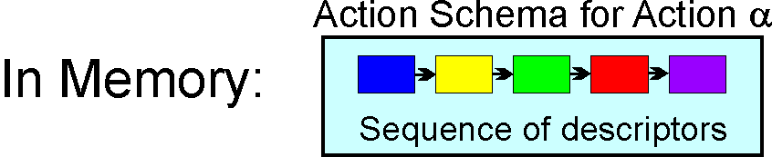
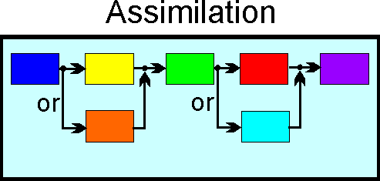
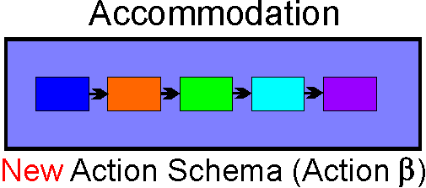

Piaget’s Accommodation and Assimilation: SECs
Yes
Action γ
≠
≠
No
Action α
≠
≠
≠
≠
Action β

Slide 22
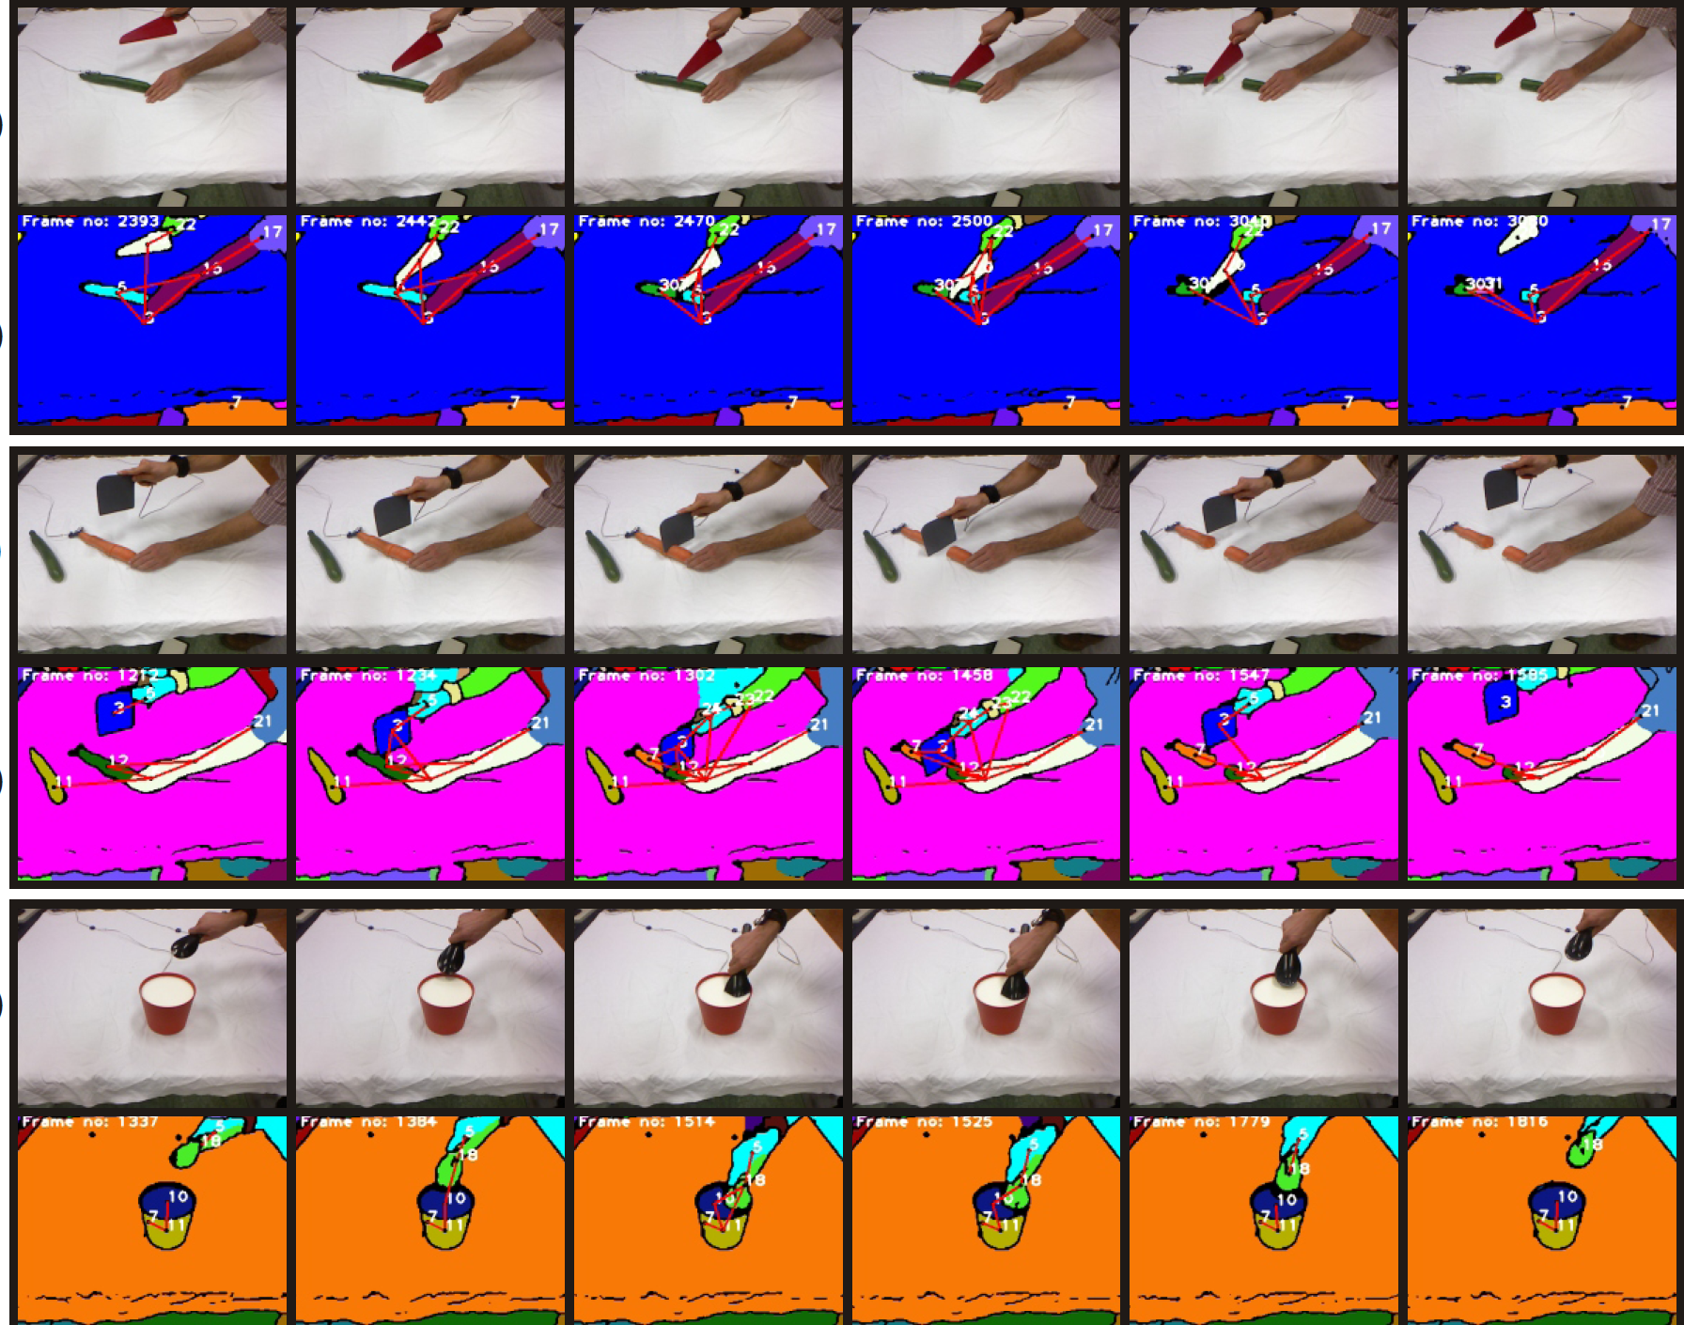
Cutting
Chopping
Stirring

Slide 23
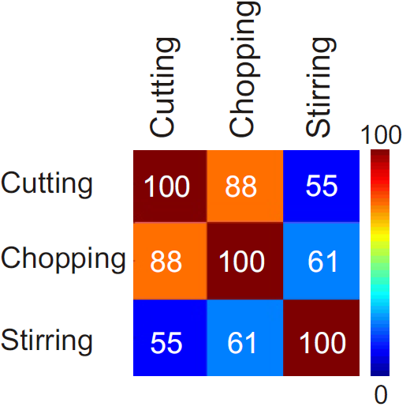
Piaget’s Accommodation and Assimilation: SECs
„Cutting“
Stirring is not similar to Cutting:
Store new schema
Accomodation: Stirring
Chopping is similar to Cutting:
Perform syntactic comparison
Assimilation: Cutting: Cutting-proper, Chopping

Slide 24
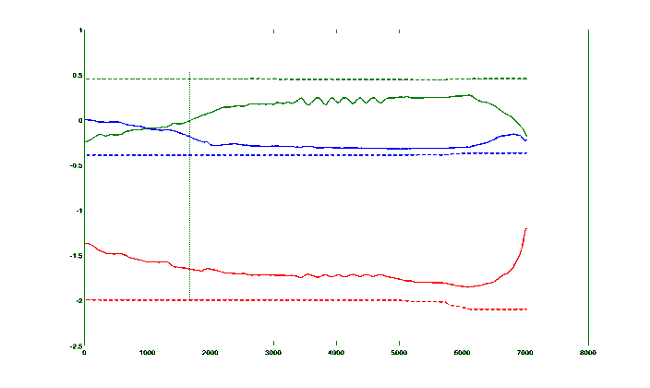
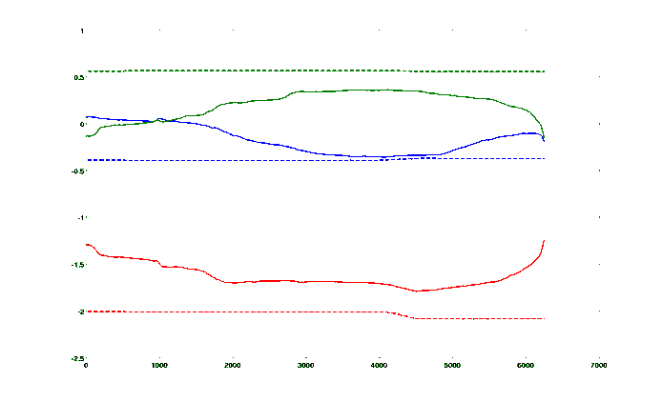
Piaget’s Accommodation and Assimilation: SECs
Allows now for more detailed comparisons
Stored Experience
Novel Observation
Cutting
Chopping
table, knife
-1 0 1 1 1 1 1 1 1 1 1 0 -1
table, cleaver
-1 0 0 1 1 1 1 1 1 1 1 0 -1
table, hand
-1 -1 -1 0 0 0 1 1 1 0 -1 -1 -1
-1 -1 0 0 0 1 1 1 0 0 -1 -1 -1
High Level (SEC) Semantic Similarity
table, new piece
-1 -1 -1 -1 1 1 1 1 1 1 1 1 1
table, hand
cucumber, knife
-1 0 0 0 1 1 1 0 0 0 0 0 -1
table, new piece
-1 -1 -1 -1 -1 -1 1 1 1 1 1 1 1
cucumber, new piece
-1 -1 -1 -1 -1 0 0 1 0 0 0 0 0
carrot, knife
-1 0 0 0 1 1 1 0 0 0 0 0 -1
knife, hand
-1 -1 -1 1 1 1 1 1 1 1 -1 -1 -1
cleaver, hand
-1 -1 -1 1 1 1 1 1 1 1 -1 -1 -1
knife, new piece
-1 -1 -1 -1 -1 1 1 0 0 0 0 0 -1
cleaver, new piece
-1 -1 -1 -1 -1 -1 1 1 1 0 0 0 -1
Objects
Objects
Detailed Level
Semantic Role
Inference
Carrot
Cleaver
Hand
Cucumber
Knife
Hand
Trajectories
Trajectories

Slide 25
Some Steps in Semantic Understanding
Schematization
(„Piaget“)
Action
Recognition
Prediction
Interpretation
(„multi-uses“)
Understanding
(„in context“)
Object
Affordance

Slide 26
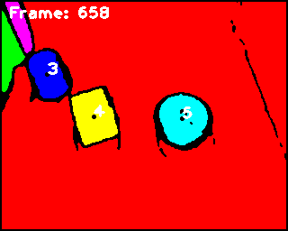
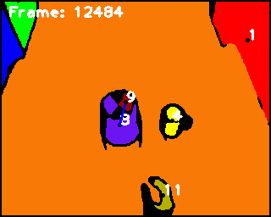
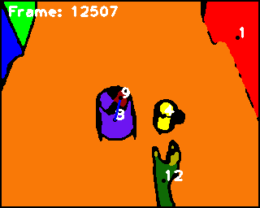
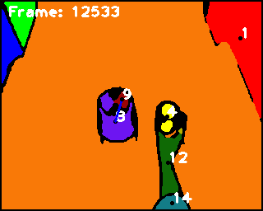
Extended Spatial Relations: eSECs
Spatial Relations
Static Spatial Relations (SSR)
Dynamic Spatial Relations (DSR)
The relations between objects’ places
(Right, Front, …)
The relations between objects’ movements (Getting Close, Moving Together, …)
Object 5 is to the right of object 4
Hand is getting close to object 4

Slide 27
Static Spatial Relations
T: Touch
N: Not-touch
R: Right
L: Left
F: Front
Ba: Back
Ab: Above
Be: Below
Bw: Between
To: Top
Bo: Bottom
I: Inside
Sa: Surround
------------------
Ab + T = To
Be + T = Bo
Ar: {L, R, F, Ba}
ArT= Ar + T
N-Ar = Ar – {ArT}
Dynamic Spatial Relations
GC: Getting Close
MA: Moving Apart
MT: Move Together
HT: Halt Together
S: Stable
FMT: Fixed Mobile Together

Slide 28
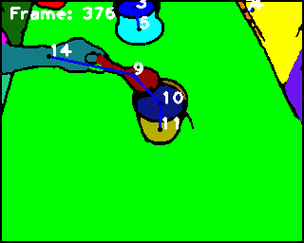
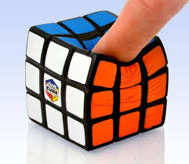
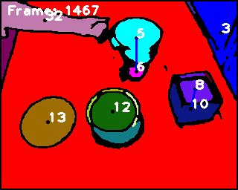

Grammar Rules
1) UUUUUU -> TUUUUU
2) TUUUUU -> TUTUUN | NUUUUU |TNUUNU
3) TUTUUN –> TNTTNN
4) TNTTNN -> NNNTNN | TNNTNN
Only certain transitions are possible: This creates a context-free grammar
(H, M):
(M, P):
(M, S):
(P, S):
(H, P):
(H, S):
Hit, Flick, Poke, Rub
(H, M):
(M, P):
(M, S):
(P, S):
(H, P):
(H, S):
Stir by a Spoon
U T T T T N
U T N
U U U N N N
U U U
U U T T N N
U U U
U U U T T T
U U U
U U U N N N
U U U
U U N N N N
U U N
6x6
6x3
Push on Top
(H, M):
(M, P):
(M, S):
(P, S):
(H, P):
(H, S):
U T T T N N
(H, M):
(M, P):
(M, S):
(P, S):
(H, P):
(H, S):
Draw by a Pencil
U T T T T T N
U U U N N N
U U N N N T T
U U T T N T
U U U T N N N
U U U T T T
U U U T N N N
U U U N N N
U U N N N N N
U U N N N N
U U U N N N N
6x6
6x7
U: Undefined, T: Touching, N: Not touching

Slide 29
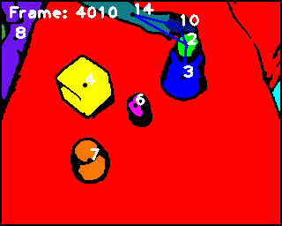
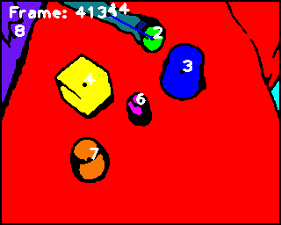
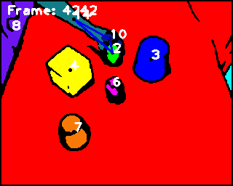
Definitions of Object’s Roles
Object | Definition
Hand | The object that performs the action
Main | The object which is directly in contact with the hand
Primary | The object from which the main object separates
Secondary | The object to which the main object joins
Main Object (M)
Primary Object (P)
Secondary Object (S)

Slide 30










A Comparison in a Cutting Action Between SEC and ESEC frameworks
Main(M): Knife
Primary(P):
Table
Secondary(S):
Cucumber
H,M | U | T | T | T | T | T | T | T | T | T | T | N | N | N
M,P | U | U | U | N | N | N | N | N | N | N | T | T | T | T
M,S | U | U | U | U | T | T | T | X | X | X | X | X | X | X
P,S | U | U | U | U | T | T | T | X | X | X | X | X | X | X
H,P | U | U | U | N | N | N | N | N | N | N | N | N | N | N
H,S | U | U | U | U | N | N | N | X | X | X | X | X | X | X
H,M | U | Ab | To | To | To | To | To | To | To | To | To | To | Ab | O
M,P | U | U | U | Ab | Ab | Ab | Ab | Ab | Ab | Ab | To | To | To | To
M,S | U | U | U | U | Ab | To | in | X | X | X | X | X | X | X
P,S | U | U | U | U | Be | Bo | Be | X | X | X | X | X | X | X
H,P | U | U | U | Ab | Ab | Ab | Ab | Ab | Ab | Ab | Ab | Ab | Ab | O
H,S | U | U | U | U | Ab | Ab | Ab | X | X | X | X | X | X | X
H,M | U | HT | HT | MT | MT | MT | MT | MT | MT | MT | MT | MA | MA | Q
M,P | U | U | U | MA | S | S | S | S | GC | GC | HT | HT | HT | HT
M,S | U | U | U | U | FMT | FMT | FMT | X | X | X | X | X | X | X
P,S | U | U | U | U | HT | HT | HT | X | X | X | X | X | X | X
H,P | U | U | U | MA | S | S | S | S | GC | GC | GC | S | S | Q
H,S | U | U | U | U | S | S | S | X | X | X | X | X | X | X
 | 1 | 2 | 3 | 4 | 5 | 6 | 7 | 8 | 9 | 10 | 11 | 12 | 13 | 14
SEC
ESEC
Static Relations
ESEC
Dynamic Relations

Slide 31
Manipulation Classification by ESEC
Discrimination Ability by ESEC
Prediction by ESEC

Slide 32


Prediction…
We want to predict a manipulation action while it is performing and before it finished.
Main (M): The Spoon, Primary (P): The table, Secondary (S): The liquid
The action is “Stirring”.
The moment of prediction:

Slide 33
Categorization of 32 manipulation actions
Wörgötter, F., Aksoy, E.E., Krüger, N., Piater J., Ude, A. and Tamosiunaite M. (2013). A Simple Ontology of Manipulation Actions Based on Hand-Object Relations. IEEE Transact. Autonomous Mental Development (TAMD) 5(2), 117-134, DOI 10.1109/TAMD.2012.2232291.

Slide 34

Prediction of Manipulations Classes

Slide 35
Prediction Results on 32 Manipulations
 | SEC | ESEC
Average $P_{E}$ | 81.02% (SD=0%) | 45.06% (SD= 6%)
By using ESEC:
All of those 32 manipulation actions are recognized correctly, whereas only 20 actions out of 32 were recognized correctly by SEC
Actions can be predicted quickly (even before half of them have been completed)

Slide 36
Some Steps in Semantic Understanding
Schematization
(„Piaget“)
Action
Recognition
Prediction
Interpretation
(„multi-uses“)
Understanding
(„in context“)
Object
Affordance

Slide 37
Object

Slide 38
Some Steps in Semantic Understanding
Schematization
(„Piaget“)
Action
Recognition
Prediction
Interpretation
(„multi-uses“)
Understanding
(„in context“)
Object
Affordance

Slide 39


What is this?
This is not a hammer!
Rene Margritte

Slide 40





Understanding Objects as Parts-Combinations
Object
Part 1
Part 2
Part 3
Syntactic
Elements
Get the parts!
r₁₂
Connections &
Poses
Object Graph
Syntax
Create Object Signature
r₁₃
r₂₃
r₁₂
Learn Part Meanings
Primordial
Semantics
Understand
New Object
Hammer or
Rake or
Poker

Slide 41
The Procedure
1A) Get part-candidates from vision (Syntactic Elements!)
1B) Create an Object Signature from part combinations (Syntax, Grammar!)
2) Learn the meaning of simple parts by supervised learning (Semantics!)
3) Look at unknown objects and understand their function from the Object Signature and the part-meanings

Slide 42
Making Object Signatures
We are getting the object parts using computer vision on point cloud data
Schoeler, M., Papon, J. and Wörgötter, F. (2015) Constrained Planar Cuts - Object Partitioning for Point Clouds, Computer Vision and Pattern Recognition (CVPR), 2015 IEEE Conference on, pp: 5207 - 5215, DOI: 10.1109/CVPR.2015.7299157.
Stein, S.C., Schoeler, M., Papon, J. and Wörgötter, F. (2014). Object Partitioning using Local Convexity, IEEE Conference on Computer Vision and Pattern Recognition (CVPR), 304-311. (DOI: 10.1109/CVPR.2014.46).
Papon, J. and Abramov, A and Schoeler, M and Wörgötter, F. (2013) Voxel Cloud Connectivity Segmentation - Supervoxels for Point Clouds. IEEE Conference on Computer Vision and Pattern Recognition (CVPR), 2027-2034, DOI: 10.1109/CVPR.2013.264.

Slide 43
Getting Parts from Vision
Making Object Signatures

Slide 44

What have we done ?
Book of Optics
ibn al-Haytham, commonly known as Alhazen
Born in Basra (now Iraq) in 965
Died around 1040
"if the body has a convex surface that bulges towards the eye [...] then if sight perceives the convexity of the surface it will perceive the body's solidity"; (p. 169, Sabra 1989).
Sabra, A.I., 1989. The optics of Ibn al-Haytham: Books I-III: On direct vision. (English translation and 438 commentary by Sabra, A.I.). London: Warburg Institute

Slide 45
First things first: How to get meaningful (for a human!) object parts from images?
Stein et al. ICRA 2014 and CVPR 2014

Slide 46


Convex-Concave Surface Transitions
In German (for school kids to
memorize):
“Convex wie ein Keks”
☺

Slide 47
Results
Remarkably: This feature seems to (most often) divide objects into “nameable” and/or “manipulatable” Primitive Parts! This points to a human-cognitive link.
Handles: we seem to build our objects to adhere to this principle.

Slide 48
Psychophysical Evidences
Human (and chimpanzees) break images at convex-concave transitions.
Bertamini, M., Wagemans, J. Processing convexity and concavity along a 2D-contour: figure-ground, structural shape, and attention. Psychon Bull Rev, 2012.
Braunstein, M. L., Hoffman, D.D. and Saidpour, A. Parts of visual objects: an experimental test of the minima rule. Perception, 18:817–826, 1989.
Cate, A.D., Behrmann, M. Perceiving parts and shapes from concave surfaces. Atten Percept Psychophys, 2010.
Chen, X., Golovinskiy, A., Funkhouser, T. A Benchmark for 3D Mesh Segmentation. ACM Transactions on Graphics, August 2009.
Hoffman, D.D. and Richards, W.A. Parts of recognition. Cognition, 1984.
Hulleman, J., Winkel, W., Boselie, F. Concavities as basic features in visual search: Evidence from search asymmetries. Perception & Psychophysics, 62 (1), /62-174, 2000.
Matsuno, T., Tomonaga, M. An advantage for concavities in shape perception by chimpanzees (pan troglodytes). Behavioural Processes, 75(3):253–258, 2007.

Slide 49

To what degree is the human “object concept” driven by convex-concave transitions
The Problem is how to measure this?
All everyday objects are for us associated to some function! They are not “just an Object”
Hermann Ebbinghaus [1850-1909] used (language) nonsense syllables to study memory
We would like to use (physical) nonsense entities to study object concepts

Slide 50



Polycubes – A “nonsense” System for Doing Psychophysics
P5
P5
+
=
P10
Build me an “Object”
Will humans minimize concavity in doing so?

Slide 51
The evidence
It seems we build our world this way….
“Red” Data Points in total: N=180
Frontiers in Psychology 2015a

Slide 52

Human can “name” these parts: A cognitive link?

Slide 53

Human can “name” these parts: A cognitive link?

Slide 54

Compare this to color-based segmentation!
Throat+Head
Fridge-fragments
No “meaningful” entities emerge !

Slide 55
Making Object Signatures

Slide 56









Annotated Part Connectivity Graph
Main conjecture: The geometrical configuration between Primitive Parts can be considered the “grammar of objects”.
Aspect 1: Object parts rarely connect to more than 2 or 3 other parts (few edges in such a graph) to form an object.
Aspect 2: As such there are no a-priori pose-limitations of how to connect any 2 parts to each other (edges need annotations).
Broken Edge: “not connected”
Annotation: “with Pose”
Node: Geon-Type
Annotated Edge:
Solid Edge: “is connected”
Annotation: “with Pose”

Slide 57















Object Signatures
$$Δ\overset{⃑}{d}$$
1
0
π/2
π
$$Δα$$
$$Δ\overset{⃑}{d}$$
$$Δ\overset{⃑}{d}$$
1
1
0
π/2
π
$$Δα$$
0
π/2
π
$$Δα$$
Signature = Histogram of distance $Δd$ vs. angle $Δα$ between points/normals. Summed over all points to all other points within the part.
$${Δd}_{ij}=‖\vec{p_{i}}−\vec{p_{j}}‖_{2}$$
$\vec{p_{i}}$ : $i$-th point in the point cloud
$$Δα_{ij}=\cos^{−1}\left(\overset{⃑}{n_{i}} ⋅\overset{⃑}{n_{j}}\right)$$
$\overset{⃑}{n_{i}}$ : normal vector of point $i$

Slide 58












Primitive Parts - Similarity Matrix
Inter-Signature Similarity
(S1 vs. S2)
$$\sum_{i}{min⁡({S1}_{i},{S2}_{i}) }$$
Hist. Intersection
Natural Clusters are observed!
1
0.5
0

Slide 59






Measuring Poses: Aspect Signatures
Variance plotted on a sphere with 80 phi and 80 theta bins → 2D variance histogram (sum of all bins normalized to 1)
y
phi
theta
x
z

Slide 60
Measuring Poses: Continuity
Align. degree

Slide 61




















This way we get (human-meaningful) syntactical elements
Grammar (“graph-like”) is relatively easy now!
99%
99%
100%
76%
72%
72%
81%
81%
77%
Nodes: Parts
Touching Edge
Edges: Pose relation
Not touching Edge

Slide 62
Some Examples of Object Graphs
99%
99%
100%
76%
72%
72%
81%
81%
77%
Nodes: Parts
Touching Edge
Edges: Pose relation
Not touching Edge

Slide 63
Object Signature
Annotated Part Connectivity Graph

Slide 64
Object Signature
99%
Descriptor (Histogram) for a Part
77%
76%
Descriptor (Histogram) for Part-to-Part Connections

Slide 65
Learning Part Meanings
for Primary Tools

Slide 66
Why Primary Tools ? – The “Monkey-Man” Perspective
Hands interact with target objects (first part of the talk)
E.g. stir with finger in cup
Tools can emulate and replace hand function.
Tool (instead of Hand) interacts with target object
E.g. stir with spoon in cup

Slide 67







Part-function association: Hand as (non-articulated) Tool
Shovel
Poker, Borer, Stirrer
Cup
Hammer
Hook
Sieve
(Rake)
Paddle, Knife

Slide 68




A guessing game: American Sign Language

Slide 69
A guessing game: American Sign Language
cut
drill
rake
Sieve (with water dropping out)

Slide 70

Why Primary Tools ? – The “Monkey-Man” Perspective
Hands interact with target objects (first part of the talk)
E.g. stir with finger in cup
Tools can emulate and replace hand function.
Tool (instead of Hand) interacts with target object
E.g. stir with spoon in cup
Hand-shapes create a small and natural training set for bootstrapping primary tool function!
Conclusion: Such tools quantitatively extend hand functionality!
Did this happen for our ancestors?

Slide 71



Hand-shape to function association: An Ontology
The Training Set
1. Layer Object shape – convex / concave
convex
concave

Slide 72

Hand-shape to function association: An Ontology
Layer 2. Object shape – Aspect ratio z/x

Slide 73
Full ontology for convex branch
Function
Tool
$d$shrinks
slow
paddle
paddle
fast
hit
rug beater
$$t⊥\vec{z}$$
$d$const
slow/fast
spread
butter knife, spatula
$$\vec{z}$$
rot $∥$ t
continuous
grind-circular
slim mill stone
Small AR
rot $⊥$t
continuous
paddle-circular
paddle steamer
$d$ shrinks
slow
NA
NA
fast
chop
cleaver, axe, sword
$$t∥\vec{z}$$
$d$const
slow/fast
cut
knife, sword
rot $∥$ t
cont./alt.
mix
mixer
rot $⊥$ t
continuous
cut-circular
paddle-circular
circular saw
paddle steamer
$d$shrinks
slow
push
hammer
$$\vec{z}$$
fast
hit
hammer
$d$const
slow/fast
grind
grinder, pestle
Convex
Here is essentially the relation to the target object encoded
Medium AR
$$t (⊥/∥)\vec{z}$$
rot $∥$ t
alternating
grind-circular
grinder, pestle
continuous
grind-circular
fat mill stone
rot $⊥$ t
continuous
grind-circular-perp.
circular grinder
$d$ shrinks
slow
push/poke
stick
fast
stab
rapier, dagger
$$t⊥\vec{z}$$
$d$const
slow/fast
draw, stir
stick, pen
$$\vec{z}$$
rot $∥$ t
cont./alt.
bore, drill
drill
High AR
rot $⊥$ t
cont./alt.
NA.
NA
$d$ shrinks
slow
push
stick
fast
whip
cane
$$t∥\vec{z}$$
$d$const
slow/fast
wipe, spread, hook
stick, hook
fast
wipe, spread
stick
needs concept of wheel + axle
rot ($∥/⊥$) t
cont./alt.
NA
NA

Slide 74
What have we achieved so far?
Object
Part 1
Part 2
Part 3
Syntactic
Elements
Get the parts!
r₁₂
Connections &
Poses
Object Graph
Syntax
Create Object Signature
r₁₃
r₂₃
r₁₂
Learn Part Meanings
Primordial
Semantics

Slide 75
Understanding New Objects

Slide 76




On Semantics: Part-function combinations
Tool-use variants
Semantics
Part/Obj.Type
 | Hammer | Hook | Poker
1 | P(Handle) | P(Handle) | P(Tip)
2 | P(Head) | P(Claws) | P(Handle)
Semantically plausible part-function recombinations

Slide 77

Part-based affordance analysis
Testing

Slide 78
Some Steps in Semantic Understanding
Schematization
(„Piaget“)
Action
Recognition
Prediction
Interpretation
(„multi-uses“)
Understanding
(„in context“)
Object
Affordance

Slide 79
Analysing Objects in/by Context

Slide 80

Where do we steal from ?
7-Word Window
sugar, a sliced lemon, a tablespoonful of apricot preserve or jam, a pinch each of,
their enjoyment. Cautiously she sampled her first pineapple which tasted sweet like sugar and then
well suited to programming on the digital computer. In finding the optimal R-stage policy from
for the purpose of gathering data and information necessary for the study authorized in the
“You shall know a word by the company it keeps!” Firth (1957)
Firth, J. R. (1957). A synopsis of linguistic theory 1930–1955. In Studies in Linguistic Analysis. Philological Society. Reprinted in Palmer, F. (ed.) 1968. Selected Papers of J. R. Firth. Longman, Harlow.

Slide 81
Image Vectors
Clustering Consistency
(example for k=3 neighbors)
Category
Instance
Vehicle
●
Animal
■
Clustering consistency means (for example):
How many animals are neighbors of one given animal?
■
CC=1
■
■
■
●
●
●
■
■
●
CC=2
■
■
●
●
Semantic Vector
Semantic Vector Space

Slide 82

What have we done ?
Analysis of Text with NLP Methods

Slide 83
What have we done ?
Analysis of Text with NLP Methods

Slide 84
What have we done ?

Slide 85
What have we done ?
Analysis of Text with NLP Methods
Let humans do the Analysis

Slide 86
Human versus System: Concept of Similarity and Relatedness
Ranking of Word Pairs
 | Tiger ---- Lion | Tiger --- Jungle
Similarity
Relatedness
High
Low
(High)
High
250 Word Pairs
Human
System
20 People, ranking of
Word Pairs: 0,…..,10
Semantic Distance ranking of
Word Pairs
Spearman Correlation

Slide 87

What have we done ?
Let humans do the Analysis

Slide 88
What have we done ?
Analysis of Text with NLP Methods
Analysis based only on image information
Let humans do the Analysis

Slide 89
What have we done ?
Analysis of Text with NLP Methods
Analysis based only on image information
Different Image-based
Methods have been used
Let humans do the Analysis

Slide 90

Of certain interest: Fully model-free ANN Method
CNN activations, which are features generated using pre-trained convolutional neural networks.
= Activity of all neurons in a flat (non-conv.) layer close to the final layer in the deep ANN (up to 1000 „features“.

Slide 91

What have we done ?

Slide 92
What have we done ?
Analysis of Text with NLP Methods
Analysis based only on image information
Let humans do the Analysis

Slide 93
Results
Human Similarity and Relatedness
Text-based Relational Analyzes
Image-based
Relational Analyzes
Human-based
Relational Analyzes

Slide 94
Some Steps in Semantic Understanding
Schematization
(„Piaget“)
Action
Recognition
Prediction
Interpretation
(„multi-uses“)
Understanding
(„in context“)
Object
Affordance

Slide 95
Analysing Scene Affordances
„Drink from“
„Put on“, „sit on“
„read“
„Put on“, „sit on“
„Put on“, „sit on“
„read“
„Put on“, „sit on“
etc.
„Grasp“
„Grasp“

Slide 96
What have we done ?
Affordance
Assignment
Network
Training
Preprocessing
Testing

Slide 97

Preprocessing
ADE20K Data Set

Slide 98
Affordance Assignment
15 Affordances
A look-up table with a few 100 entries

Slide 99
Network Training
GT=ground truth
Expected
Affordance
(GT)
Actually measured
Affordance
Mask
Affordances of any kind exist only therein
Error (for backprop):
Norm. Fact.
All Aff.
All Pixels
Binary Entropy:
Calculated from probabilities p for: „Does an affordance for a given pixel hold?“

Slide 100
Why would a network do this ?
Convolution
„Features“
Image
„Features“
Image-segments
De-Convolution
Dense-Refine ResNet

Slide 101
Testing
Place-on (red), Pinch-Pull (blue), Hook-pull (green)
Place-on (red), Walk (purple), Read (yellow)
Grasp (blue)

Slide 102
In Detail
Walk (purple), Read (yellow), Grasp (blue)
Place-on (red), Pinch-Pull (blue), Hook-pull (green)
Multiple Affordances can exist for one segment
Affordance-Reliability is coded by color-intensity.

Slide 103
Some Steps in Semantic Understanding
Schematization
(„Piaget“)
Action
Recognition
Prediction
Interpretation
(„multi-uses“)
Understanding
(„in context“)
Object
Affordance

Slide 104
Some Steps in Semantic Understanding
Schematization
(„Piaget“)
Action
Recognition
Prediction
Interpretation
(„multi-uses“)
Understanding
(„in context“)
Object
Affordance

Slide 105
Thanks
A. Aksoy: SECs
F. Ziaatabar and M. Tamosiunaite: eSECs
M. Schoeler: Object Interpretation from Parts
T. Lüddecke: Object Concepts and Scene Affordances
M. Tamosiunaite: Action Understanding
Funding
EU-H2020: ReconCell, Plan4Act and Imagine

Slide 106

Universität Göttingen, Institute for Physics 3 – Biophysics
Machine Vision Machine Learning Robotics Computational Neuroscience

Slide 108








Algorithm – Similarity Measure
“Cutting a Cucumber”
ρ 2,1
“Cutting a Paprika”
ρ 6,1
A
T
T
T
T
T
≈
N
T
T
A
A
ρ 3,1
ρ 3,1
A
N
N
N
T
T
T
A
T
T
N
ρ 2,1
ρ 4,1
A
A
N
88 %
T
T
T
A
T
T
N
N
ρ 3,2
ρ 6,2
A
N
A
T
T
T
T
A
N
T
N
≈
ρ 3,4
A
ρ 6,3
A
N
T
T
T
A
N
N
T
T
ρ 3,7
5X6
A
N
N
N
A
6X5
18 %
41 %
15%
39 %
“Stirring Orange juice”
“Stirring Coke”
ρ 5,6
ρ 7,1
A
N
N
T
T
T
N
T
N
N
T
T
T
T
ρ 3,6
A
≈
ρ 3,1
A
N
T
T
N
A
A
N
T
T
N
N
N
ρ 4,6
A
T
ρ 5,1
N
T
N
T
A
N
T
T
T
T
T
ρ 3,5
94 %
N
T
A
ρ 3,7
A
T
T
T
A
A
N
T
T
T
N
A
ρ 4,5
N
T
T
N
N
N
T
ρ 5,7
≈
A
T
ρ 3,8
N
T
N
T
A
T
N
N
T
T
T
T
5x7
6x7

Slide 110
From Word Vectors to Object Vectors from Images
What company does it keep?
Semantic Vector

Slide 111
Human versus System: Similarity and Relatedness Ranking
250 Word Pairs A-B
Human
System
Word A
Word B
d
■
■
■
●
20 People, ranking of Word Pairs: 0,…..,10
●
●
■
■
●
■
Different
humans
●
●
Semantic Vector Space
Average across people for every Word Pair
Distance d for every Word Pair
Ranklist of all Word Pairs
Ranklist of all Word Pairs
Spearman Correlation

Slide 112
What have we done ?
Three types of descriptors are compared (see numbering in the figure):
Human-assigned object labels,
2) Object labels automatically obtained by applying an RCNN (Girshick et al., 2014) to detect objects, and
3) CNN activations, which are features generated using pre-trained convolutional neural networks.
Ross Girshick, Jeff Donahue, Trevor Darrell, and Jitendra Malik. 2014. Rich feature hierarchies for accurate object detection and semantic segmentation. In IEEE Conference on Computer Vision and Pattern Recognition (CVPR). IEEE, pages 580–587

Slide 113
Results
Clustering
Consistency
Not shown:
„mildly worse“
Random

Slide 114
What have we done ?
Different Image-based
Methods have been used

Slide 115

Quantification
Definition: Intersection over Union (IoU)
Some baseline methods

Slide 116
Piaget’s Accommodation and Assimilation
Assimilation: Entering new entities into existing schemas.
Accommodation: Storing new schemas.
Schema for Mammals: Mammals have 4 legs.
Schema: Mammal_4: Dog
Assimilation:
A cat has 4 legs: This fits to the schema and, thus, it is a mammal.
Schema extension: Mammal_4: Dog, Cat
Jean Piaget
1896 – 1980
Dolphins have no legs but they are mammals.
Accommodation:
Mammals can have no legs (new schema)
Robotics Example:
Cutting Chopping Stirring
Two Schemas: Mammal_4
: Mammal_0

Slide 117
 | Hairy | 4-legged | With tail | Vivipar | 2-legged | Feathery | Ovipar
Dog | x | x | x | x
Cat | x | x | x | x
Elephant |  | x | x | x
Platypus | x | x | x |  |  |  | x
Eagle |  |  |  |  | x | x | x
Peacock |  |  | x |  | x | x | x
Mammal
Mammal
Mammal
Mammal
Bird
Bird

Slide 118



Georg-August University Göttingen
founded 1734, currently about 35,000 students
The Gänseliesel (Goose-Girl) Fountain
near the old city hall
A very old tradition:
On getting their PhD, students have to kiss the Gänseliesel (Goose-Girl) and give her some flowers!

Slide 119
Object Signatures
$$Δ\overset{⃑}{d}$$
1
0
π/2
π
$$Δα$$
$$Δ\overset{⃑}{d}$$
$$Δ\overset{⃑}{d}$$
1
1
0
π/2
π
$$Δα$$
0
π/2
π
$$Δα$$
Signature = Histogram of distance $Δd$ vs. angle $Δα$ between points/normals. Summed over all points to all other points within the part.
$${Δd}_{ij}=‖\vec{p_{i}}−\vec{p_{j}}‖_{2}$$
$\vec{p_{i}}$ : $i$-th point in the point cloud
$$Δα_{ij}=\cos^{−1}\left(\overset{⃑}{n_{i}} ⋅\overset{⃑}{n_{j}}\right)$$
$\overset{⃑}{n_{i}}$ : normal vector of point $i$

Slide 120




Measuring Poses: Relative Poses
This signature captures the alignment of the entities
Histogram intersection
Sum of all bins: 1
Sum of all bins: 1
Binsum (Align. degree): 0.49
You could think of this as the „alignment“ of both objects

Slide 121




Signatures of Parts
$$Δ\overset{⃑}{d}$$
$$Δ\overset{⃑}{d}$$
$$Δ\overset{⃑}{d}$$
$$Δα$$
$$Δα$$
y
z
x
$$Δα$$

Slide 122
Aspect Signature
Align. degree : 0.77
Align. degree : 0.76
Align. degree : 0.99

Slide 123
Piaget’s Accommodation and Assimilation: SECs
Assimilation
Stored Experience
Novel Observation
Cutting
Chopping
table, knife
-1 0 1 1 1 1 1 1 1 1 1 0 -1
table, cleaver
-1 0 0 1 1 1 1 1 1 1 1 0 -1
table, hand
-1 -1 -1 0 0 0 1 1 1 0 -1 -1 -1
table, hand
-1 -1 0 0 0 1 1 1 0 0 -1 -1 -1
table, new piece
-1 -1 -1 -1 1 1 1 1 1 1 1 1 1
table, new piece
-1 -1 -1 -1 -1 -1 1 1 1 1 1 1 1
cucumber, knife
-1 0 0 0 1 1 1 0 0 0 0 0 -1
carrot, knife
-1 0 0 0 1 1 1 0 0 0 0 0 -1
cucumber, new piece
-1 -1 -1 -1 -1 0 0 1 0 0 0 0 0
cleaver, hand
-1 -1 -1 1 1 1 1 1 1 1 -1 -1 -1
knife, hand
-1 -1 -1 1 1 1 1 1 1 1 -1 -1 -1
cleaver, new piece
-1 -1 -1 -1 -1 -1 1 1 1 0 0 0 -1
knife, new piece
-1 -1 -1 -1 -1 1 1 0 0 0 0 0 -1
Objects
Objects
Cucumber
Knife
Hand
Carrot
Cleaver
Hand
Trajectories
Trajectories

